Slide 1

Introduction to Pathways
Pathways Data | Advanced Searching and Reports

Slide 2
Introduction to Pathways Resources
Pathways Overview | Appointment Scheduling and Messaging Students | Navigate360 Student Overview
Pathways and PeopleSoft | Utilizing Student Lists and Appointment Campaigns
Documentation in Pathways: Appointment Summaries and Notes
Pathways Referrals and Case Management
Pathways Data | Advanced Searching and Reports
In this video, we’ll focus on the types of data within Pathways and how advanced searches and reports within the platform allow access to this data. You’ll learn when to use an advanced search versus a Pathways report and how results can be used to provide coordinated and differentiated support to students on our campuses.
By the end of this session, you'll have a better understanding of how to use these tools effectively in your daily work and know where to find additional resources and support when needed.
Introduction to Pathways

Slide 3
Pathways Data
Data in Pathways consists of both PeopleSoft and other university integrated data, as well as platform-specific data created by the daily usage of the platform.
This data is available via the searching and reporting capabilities directly within Pathways.

Slide 4
PeopleSoft ➡️ Pathways
Integrated with PeopleSoft, Pathways provides a user-friendly view of data, and a place to interact with it
PeopleSoft data that flows into Pathways include:
  Categories
    Platform-wide identifiers that are used to group students into sub-populations based on specific attributes (Campus, Career/Classification, Cohorts, PeopleSoft Academic Standing, etc.)
  Courses
  Grades
  Advisor Assignments
⚠️ Data downloaded from PeopleSoft flows into Pathways each morning
This means any data that is updated in PeopleSoft will take 24 hours (sometimes 36 hours) to reflect in Pathways
Introduction to Pathways

Slide 5
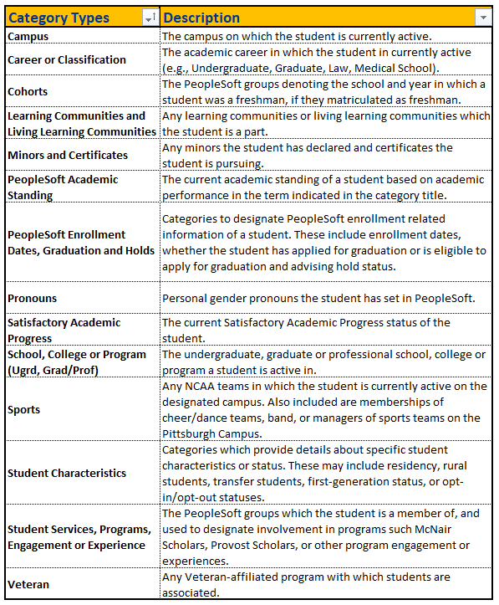
Category Data and Custom Attributes
Many searches or reports that you create in Pathways will make use of category data – this allows you to limit the results to only the specific data and population of students you want to identify or the population of students you support.
Custom attributes allow for key data points from other university systems or data sources to be integrated into Pathways for purposes of searching and reporting.
Introduction to Pathways

Slide 6
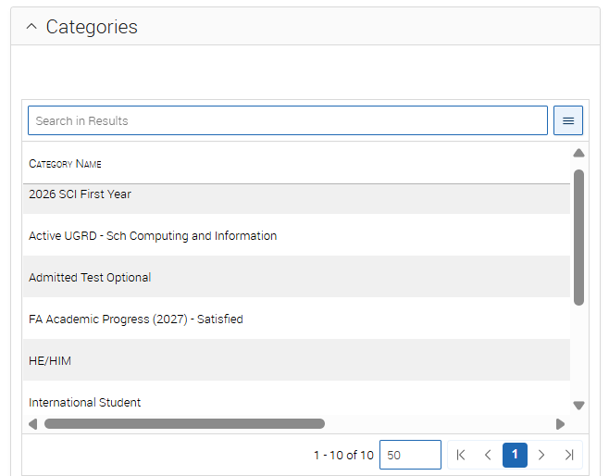
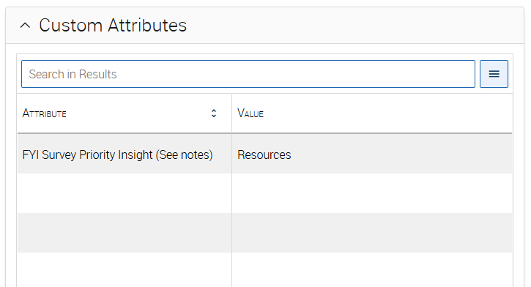
Data on the Student Overview Tab
Categories on the student overview tab
Custom Attribute on student overview tab
Introduction to Pathways

Slide 7




Pathways Platform User-Created Data
Data is also created by university staff and faculty via the daily use of Pathways
Notes Reasons
Appointments & Appointment Summaries
Progress Reports
Referrals & Case
Platform users can also add Tags to students which become useful filters in searches and reports
Introduction to Pathways

Slide 8
Accessing Data via an Advanced Search or Report
Using the searching and reporting capabilities in Pathways allows users to access this data on-demand, and without the need to put in a special data request.

Slide 9
Advanced Searches vs Pathways Reports
 | Advanced Search | Pathways Reports
What is it | An advanced search allows you to find individual or populations of students, based on the various filters that you select. | Pathways Reports provide access to Pathways user-created data, such as referrals/cases, progress reports, appointments and appointment summaries. Much like advanced searches, most reports will make use of categories as one of the primary filters.
Who has access | Most platform users have access to perform an advanced search. However, the data they can search on may vary slightly based on the role they have within the platform. | Access to reports varies by the role that a user has in the platform.
When to use it | Conduct an advanced search when you want to identify a list of students based on specific PeopleSoft data, and/or Pathways tag data. | Reports will be used when you are trying to access Pathways-specific data for purposes of conduct student outreach, or for analyzing platform usage (such as for year-end usage reports.)
Introduction to Pathways

Slide 10
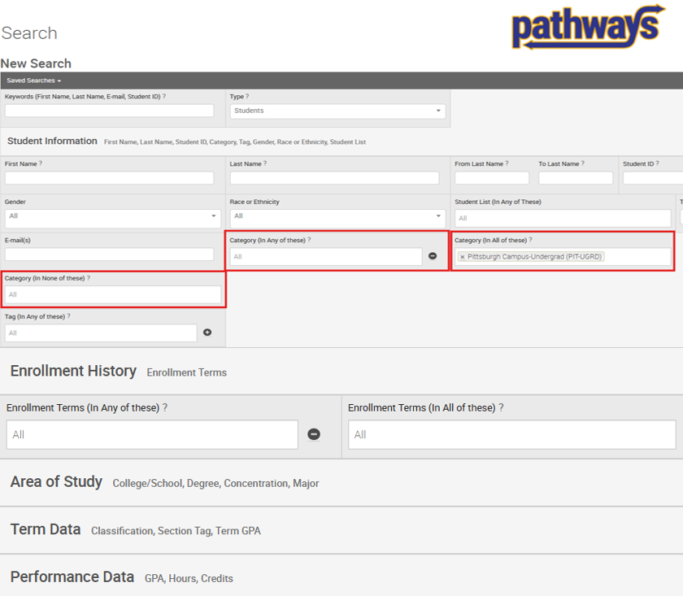
Advanced Search
Identify a list of students who meet the selected search criteria
Category data, or other PeopleSoft academic data are used as filters in advanced searches
The results of an advanced search will be a single row for each student
Introduction to Pathways

Slide 11
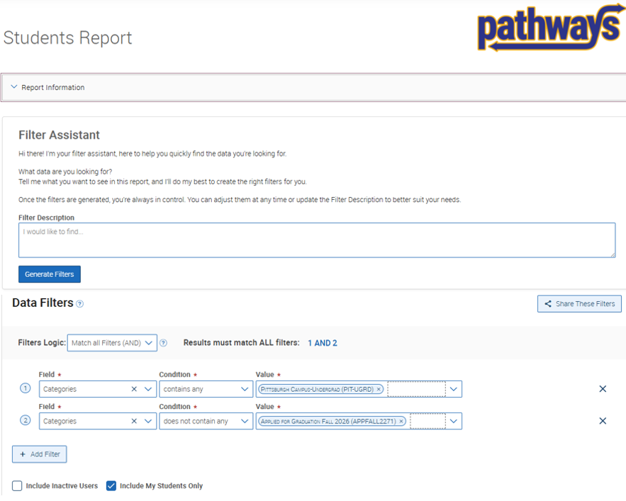
Pathways Reports
Pathways Reports provide access to Pathways user-created data – the results of the report will be dependent on the type of report you are using
Categories remain a common filter in reports
Our team has created templates for commonly used reports – While the platform also an AI filter assistant that can help you get started in identifying the filters necessary to get the results you want
Introduction to Pathways

Slide 12
Types of Pathways Reports
Most users have access to the first three reports detailed below. However, you may also have access to additional reports listed in the right-hand column, depending on your role in the university and in Pathways.
Progress Reports Report
Student Enrollments Report
Students Report
Appointments
Appointment Summaries
Appointment Campaigns
Notes
Check-ins
Referrals
Cases
Pre- and Post- Appointment Questions
Surveys
The Progress Reports Report shows all responses created by instructors during the Early Progress Reporting period.
There will be one row for each progress report that has been submitted for a student.
The Students Enrollments Report shows any course enrollments a student has in the selected term.
There will be one row for every instance of enrollment for a student – including recitations, dropped and withdrawn courses.
The Students Report shows general information about students in the platform. In most cases, it can be used as a substitute for advanced searches.
There will be one row of data for each student who meets the search criteria.
Introduction to Pathways

Slide 13
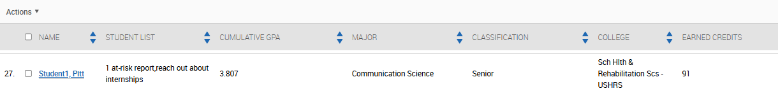
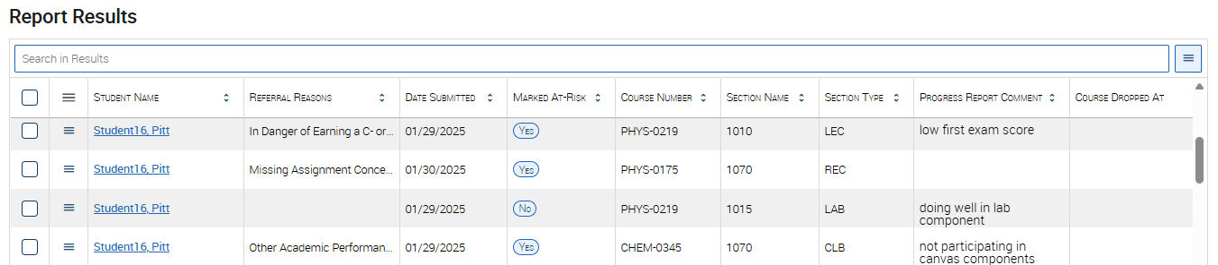
Advanced Search and Report Results
Advanced search results will be a single row for each student. The columns of included data will be the same, regardless of the search filters used.
Results in a report will depend on the report you are using. While many reports include similar columns of data as an advanced search, there are report-specific data columns for each report. You will often see multiple rows of data for each student.
Introduction to Pathways

Slide 14
Benefits and Reasons for Utilizing Searches and Reports

Slide 15
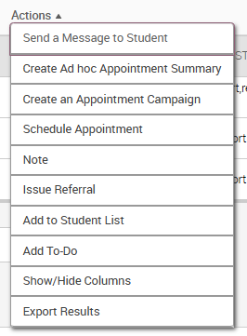
Differentiated Support
You just created an advanced search or report – Now what? In many cases, the results in an advanced search or report provide an opportunity to conduct differentiated outreach.
  Add them to a student list that you can use across the platform
  Schedule an appointment with them Create/add the students to an appointment campaign
  Send them a message
  Issue a referral
  Add a to-do or staff task
Introduction to Pathways

Slide 16
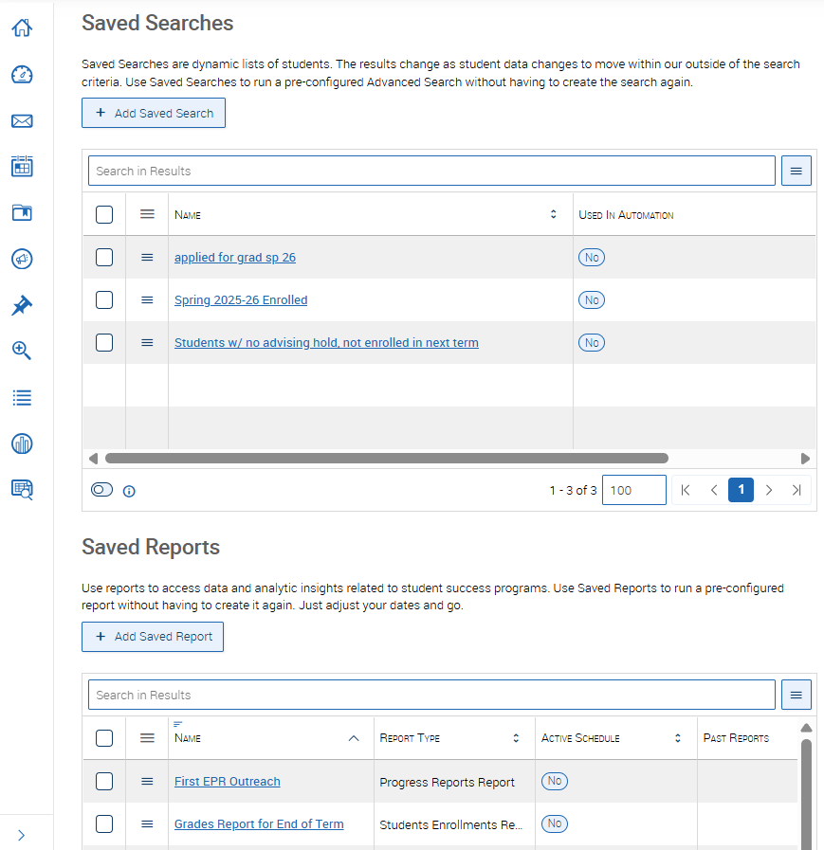
Work Efficiently with Pathways
Pathways allows staff and faculty to work efficiently. The student lists that you create from one advanced search can be used as a filter in another.
Advanced searches and reports can be saved for quick access in the current or future term. As the data in Pathways changes, the results will be updated each time you run the search or report.
Introduction to Pathways

Slide 17
Insight into Student Support
Identify opportunities for proactive outreach at both the individual student level and for key populations of students.
Review annual usage data and identify trends over time.
Opportunities to analyze potential gaps in support and areas of opportunity.
Utilize the data to measure effectiveness of programming, support and interventions, and their impact on key student outcomes.
Keep in mind – Utility and accuracy of report results are impacted by correct usage of platform users. Because of this, it is important to follow best practices, and have consistency among department users when it comes to platform usage and documentation.
Introduction to Pathways

Slide 18
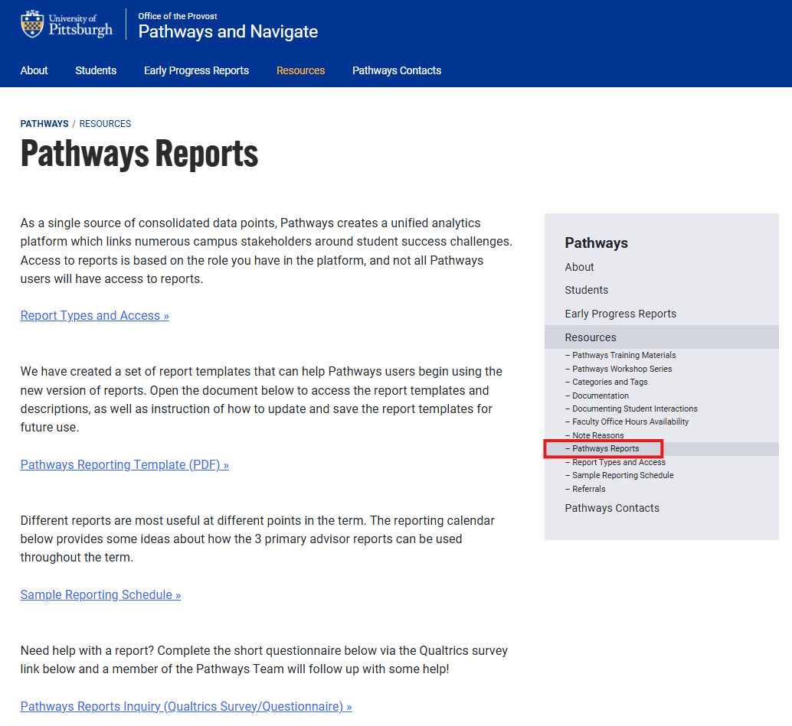
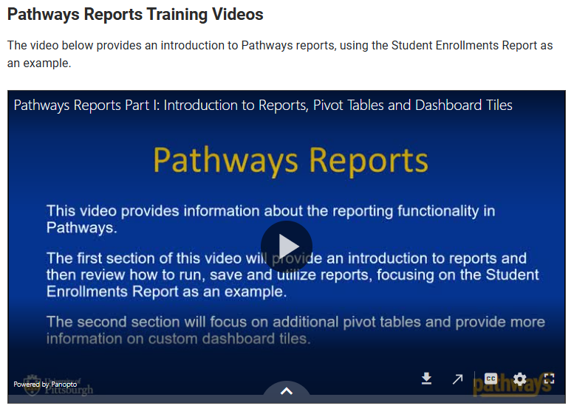
Training Resources
Introduction to Pathways

Slide 19
Training Resources (cont.)
Categories and Tags
How-to Create an Advanced Search
Pathways Reports - Resources and How-to Videos
Referenced Differentiated Support Training Resources
  Creating, Managing and Using Student Lists
  Scheduling Appointments
  Creating Appointment Campaigns
  Messaging Students
  Issuing Referrals
  Adding and Managing To-Dos and Staff Tasks
  Adding and Managing Tags
Introduction to Pathways

Slide 20
Questions?
Contact SST-Technology@pitt.edu

