Slide 1

Introduction to Pathways
Pathways Overview | Appointment Scheduling | Messaging Students | Navigate360 Student

Slide 2
Introduction to Pathways
Pathways Overview | Appointment Scheduling | Messaging Students | Navigate360 Student
Pathways and PeopleSoft | Utilizing Student Lists and Appointment Campaigns
Documentation in Pathways: Appointment Summaries and Notes
Pathways Referrals and Case Management
Pathways Data | Advanced Searching and Reports
In this session, we’ll provide an overview of Pathways and its impacts, along with some of its main features and functionalities, including appointment scheduling, messaging students, and Navigate360 Student. By the end of this session, you'll have a better understanding of what Pathways is & why it matters, some of its core features, and where to find additional resources and support when needed.
Introduction to Pathways

Slide 3
Pathways Overview
What is Pathways?
Pathways Impact
Benefits
Navigate Staff & Staff Home
Quick Set-Up
Getting Started - Resources

Slide 4
What is Pathways?
Pathways is a coordinated effort led by faculty, staff, and academic leadership to utilize the Education Advisory Board's (EAB) Navigate360 Student Success platform
A tool to support advising responsibilities among faculty & staff and plays an increasingly important role in supporting student success
Integrated with PeopleSoft, Pathways provides a user-friendly view of data
Pathways is FERPA-compliant
Introduction to Pathways

Slide 5
Pathways Impact
Pathways has a major impact on the work Pitt can do to support students from initial enrollment to graduation.
By combining technology and best practice research, Pathways helps Pitt leverage data and manage advising and academic support resources to increase retention and graduation rates for students.
Pathways enables Pitt to improve student outcomes in the short term (e.g., retention and persistence to graduation for undergraduate students) so that our graduates will lead lives of impact after graduating from Pitt.
Introduction to Pathways

Slide 6
Pathways Benefits
Visibility into student risk
With real-time, in-semester data on student behavior, Pathways enables Pitt to focus, coordinate, and integrate student support and help students make good decisions—before they may even realize they need help.
Quick access
Critical information and an intuitive interface streamlines administrative work and saves faculty & advisors time.
More impactful advising
Improved utilization of support services
Scheduling
Referrals
The system’s data alerts and problem identification prompt meaningful conversations with students and encourage follow-through.
The system provides guidance for students to the appropriate support services—such as tutoring, financial aid, or career counseling—which can sometimes be difficult to navigate.
A simple-to-use interface allows students to streamline scheduling appointments with advisors.
A robust, centralized referral system makes it easy for advisors and instructors to provide wraparound service and support.
Introduction to Pathways

Slide 7
Navigate Staff
Displays Academic Data in a User-Friendly Way
Appointment Scheduling
Searching for & messaging students
Leaving/viewing notes/summaries of appointments
Referring students to other offices/staff
Early progress reporting
Introduction to Pathways

Slide 8
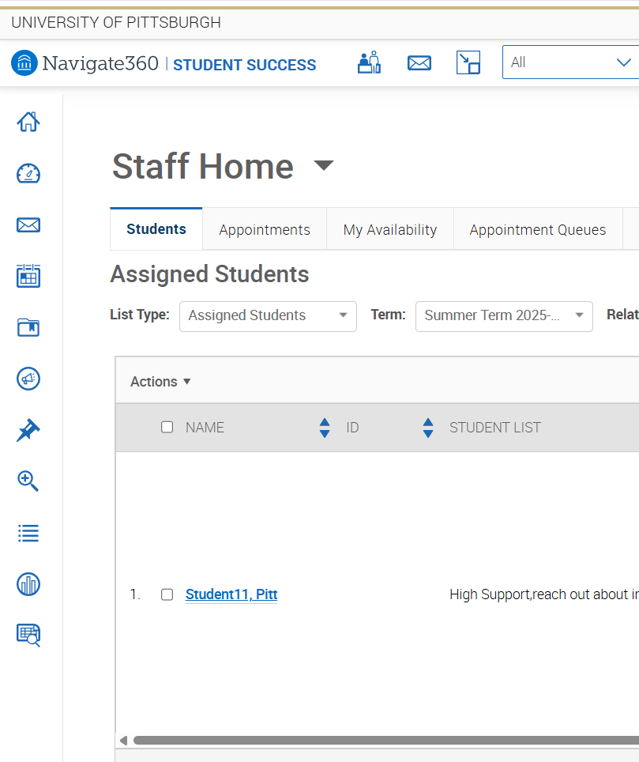
Staff Home
Staff Home is the default landing page for staff in Pathways and is the first page you will see when you log into the platform
Staff Home has many important elements that show:
  Students assigned to you
  Upcoming appointments
  Appointment Summary Reports
It’s also where you can/will access and set-up your:
  Appointment Queues
  Availability
Introduction to Pathways

Slide 9
Quick Set-Up
Meeting with students
  Create your availability (required)
  Sync your calendar (highly recommended, though not required)
Messaging students
  Create your email signature (highly recommended)
    Include your Personal Availability Link (PAL)
Working efficiently
  Set your Default Page Tabs
    Default Staff Home Tab
    Default Care Unit
    Default Location
Introduction to Pathways

Slide 10
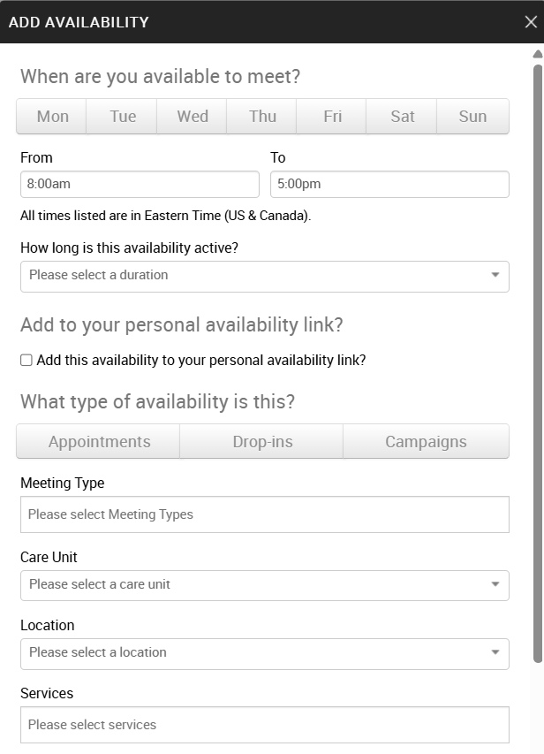
Quick Set-Up
Creating your availability
Appointment availability is the most important step for staff who want to leverage Pathways’ appointment scheduling and management capabilities.
Availability impacts when and how your students experience the scheduling workflow.
Availability determines when students can schedule appointments or drop in with you.
Introduction to Pathways

Slide 11
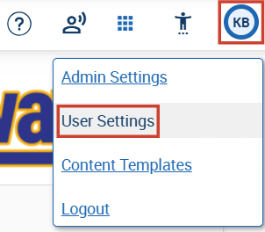
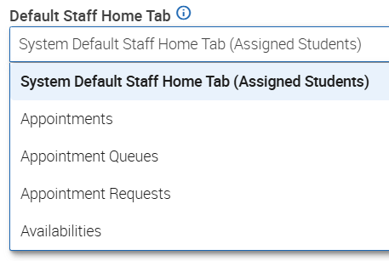
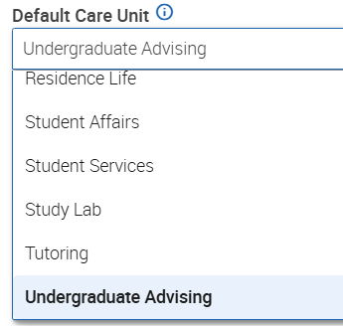
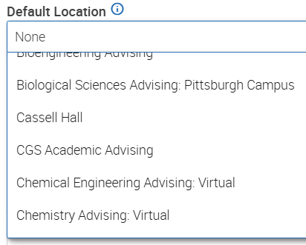
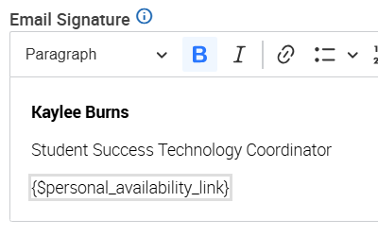
Quick Set-Up (User Settings)
Creating your Email Signature
Default Staff Home Tab
Default Care Unit
Default Location
Choose a Default Staff Home Tab to specify which tab you prefer to land on when accessing your home page
Choose a Default Care Unit to specify which care unit will be preselected by default on all new ad hoc appointment summaries
Choose a Default Location to specify which location will be preselected by default on all new ad hoc appointment summaries
Introduction to Pathways

Slide 12
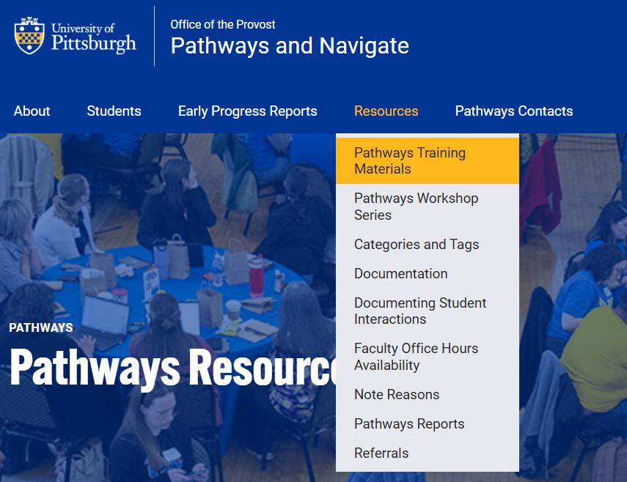
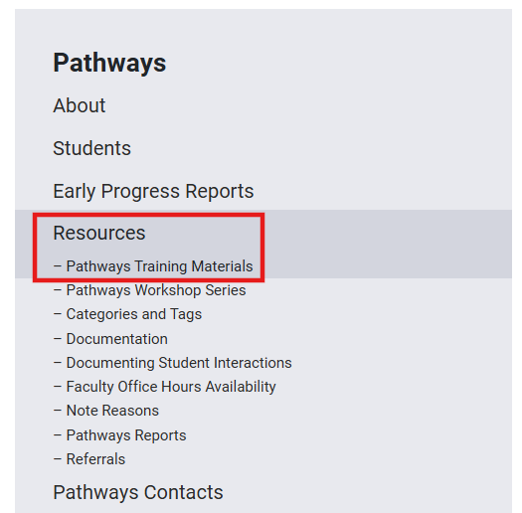
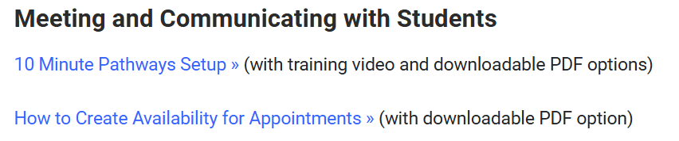
Getting Started With Pathways - Resources
Introduction to Pathways

Slide 13
Getting Started With Pathways – Resources
Overview
Pathways – General
Pathways Training Materials
  10-Minute Pathways Setup
  How to Create Availability for Appointments
  How to Create Appointment Summaries
Additional training materials cover relevant topics, such as:
  Appointment Scheduling
  Early progress reporting
  Advanced searching for students
  …and more!

Slide 14
Appointment Scheduling
Overview & Resources

Slide 15
Appointment Scheduling - Overview
Staff (advisors, mentors, etc.) can manually schedule, edit or cancel appointments with students
Ways & places to schedule an appointment
  The student’s page
  Your Assigned Student List
  Advanced Search or Report
NOTE: you may not be able to edit or cancel appointments if you are not the organizer of the appointment or if you do not have access to manage appointments in the specific Care Unit that the appointment is scheduled in
Introduction to Pathways

Slide 16
Pathways Resources
Appointment Scheduling
Pathways Training Materials
  How to Schedule, Edit and Cancel Appointments
  Appointment Scheduling PDF
Introduction to Pathways

Slide 17
Messaging Students
Overview
Policies & Guidelines

Slide 18
Messaging Students - Overview
There are two primary communication methods available in Pathways: Email and Text.
The type of message, as well as Pitt’s configurations and policies, dictate the appropriate method for communication.
Introduction to Pathways

Slide 19
Messaging Students
Email
Messaging multiple students functions like a Bcc email.
When a student replies to your email message, you will receive the response via email, and you can see and reply within Pathways or your desktop/mobile email app.
Text Message (SMS)
SMS messages to multiple students appear as an individual text.
Texts sent to 1000 students or less will come from a random pooled phone number. If a student texts back, you will get the response via email. If you message back from within Pathways; it will go back to the student as a text.
Texts sent to 1000+ students will come from the bulk message number, (412) 866-1787, and students cannot text back.
Students can opt-out of receiving bulk text messages. If a student has opted out of text messages, then texts from the pooled number or short code will be delivered via email instead.
Introduction to Pathways

Slide 20
Messaging Students – Policies & Guidelines
Texting should be reserved for important or time sensitive messages.
Resources
  See the Pathways website for the text messaging policy and communication guidelines.​
Introduction to Pathways

Slide 21
Navigate360 Student
Overview
Mobile App & Desktop
Student Resources

Slide 22
Navigate360 Student - Overview
The website staff use to access Pathways is not the same as what students use.
Most students access their version of Pathways using the Navigate Student App for Pathways, which is a mobile app they can download that gives them access to a number of student facing resources. They also can access the platform through desktop. ​
In either modality, students are able to take actions, such as:
  Scheduling appointments
  View their success team (such as their assigned academic advisor)
  See notes created and made visible by their advisor
  Review Progress Reports submitted by instructors
  …and more!
Introduction to Pathways

Slide 23
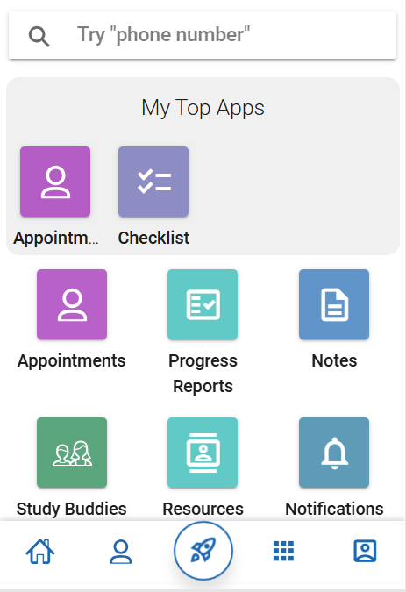
The Navigate Student Mobile App
The Navigate Student App provides a
user friendly way for students to interact with information and resources.
Introduction to Pathways

Slide 24
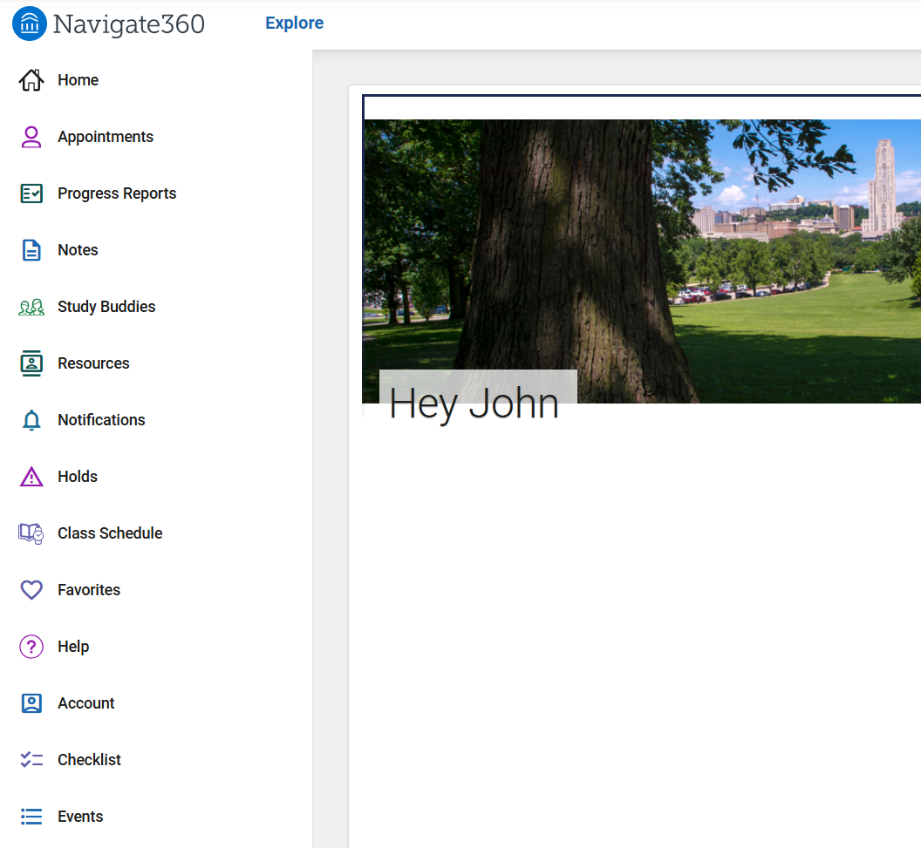
The Navigate Student Website/Desktop Version
The Navigate Student website/desktop version looks a bit different than the mobile app but provides the same information and functionality.​
Introduction to Pathways

Slide 25
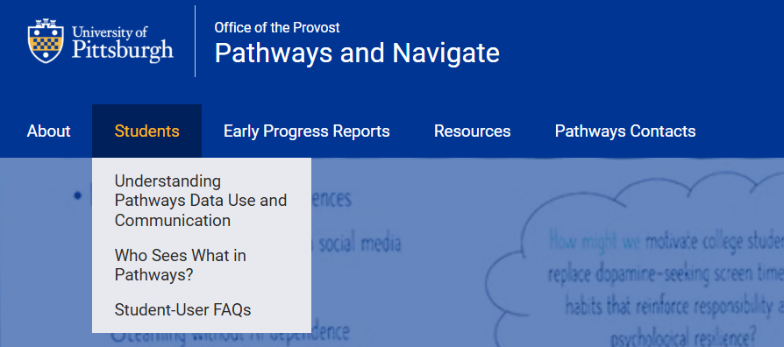
Student Resources & Support
Promoting student success is at the heart of Pathways. Our site provides information for students about what the platform means for them.
Introduction to Pathways

Slide 26
Questions?
Questions?
Contact SST-Technology@pitt.edu

