Slide 1

Introduction to
Documentation in Pathways | Appointment Summaries and Notes

Slide 2
Introduction to Pathways Resources
Getting Started with Pathways, Appointment Scheduling and Messaging Students | Navigate360 Student Overview
Pathways and PeopleSoft | Utilizing Student Lists and Appointment Campaigns
Documentation in Pathways | Appointment Summaries and Notes
Pathways Referrals and Case Management
Pathways Data | Advanced Searching and Reports
In this video, we'll focus on Documentation in Pathways, specifically Appointment Summaries and Notes. By the end of this session, you'll have a better understanding of the purpose of documentation, when Appointment Summaries and Notes are used, and the general principles for creating effective documentation in your daily work. You’ll also know where to find additional resources and support when needed.
Introduction to Pathways

Slide 3
Why Document Advising Interactions?
Create a shared record of student interactions and institutional memory
Support smooth transitions between advisors and student support resources
Track recommendations and referrals
Document student progress over time
Provide context for future interactions
Introduction to Pathways

Slide 4
Appointment Summaries & Notes
 | Appointment Summaries | Notes
When to use | Document interaction and details about a scheduled appointment or drop-in meeting. | Document important student-related information, conversations, or updates that are not part of a scheduled appointment.
Guidelines | Summarize important information discussed in the appointment. Summaries should be fact-based and not include sensitive information. | Notes should include relevant and important information. Notes should be fact-based and not include sensitive information.
Visibility | Visible to users who have access to see appointment summaries within the Care Unit where the summary exists. | Visible to all users who have access to view notes in Pathways, unless restricted to a Care Unit. Notes can be marked private to restrict the audience. Notes can be made visible to the student.
FERPA | Subject to FERPA requests. All Appointment Summaries and Notes become part of the student’s record.
Introduction to Pathways

Slide 5
Note Reasons
Advising Appointment Summary
Enrollment-Change of Major or Plan
Enrollment-Leave of Absence
Enrollment-Reinstatement
Enrollment-Resignation
Enrollment-Schedule Change
Enrollment-Withdrawal
Experiential Learning
Other Issues Impacting Academics
Outreach-Academic Standing
Outreach-Continuing Enrollment
Outreach-Course Grades or Repeats
Outreach-Early Progress Reports
Outreach-General Check in
Outreach Satisfactory Academic Progress
Student Records-Exceptions and Approvals
Student Records-Incoming Credit Review
Survey
Introduction to Pathways

Slide 6
Sample Appointment Summary and Note
The next section provides images of an appointment summary and note in Pathways

Slide 7
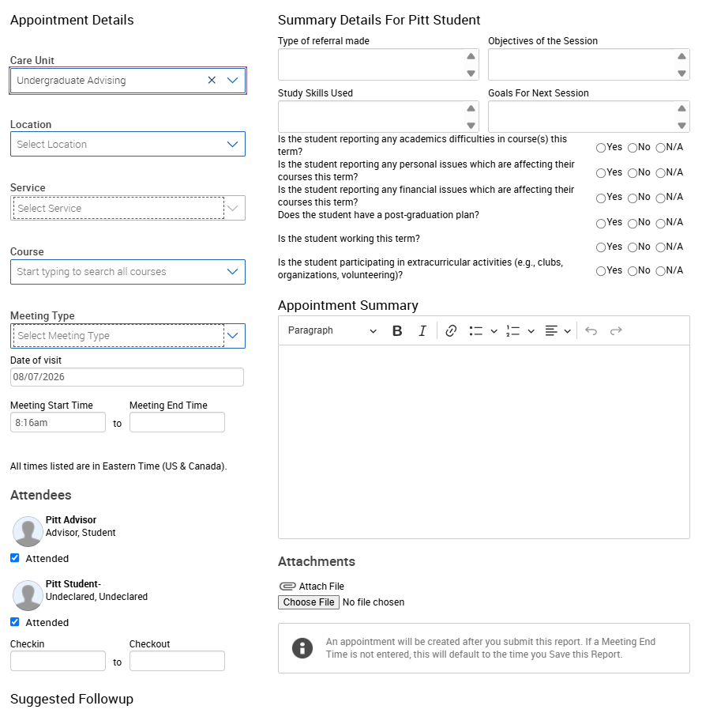
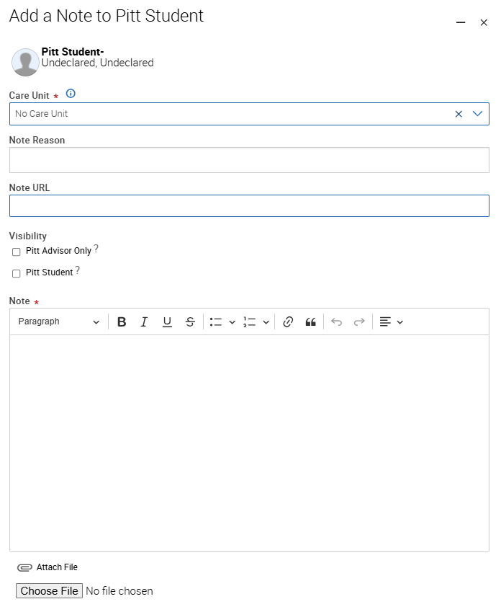
Sample Appointment Summary and Notes (Pathways Images)
Introduction to Pathways

Slide 8
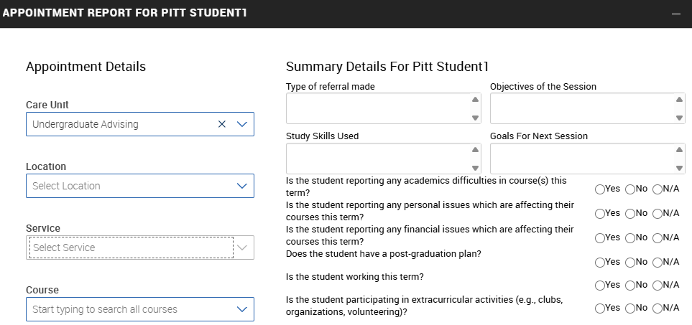
Sample Appointment Summary
Introduction to Pathways

Slide 9
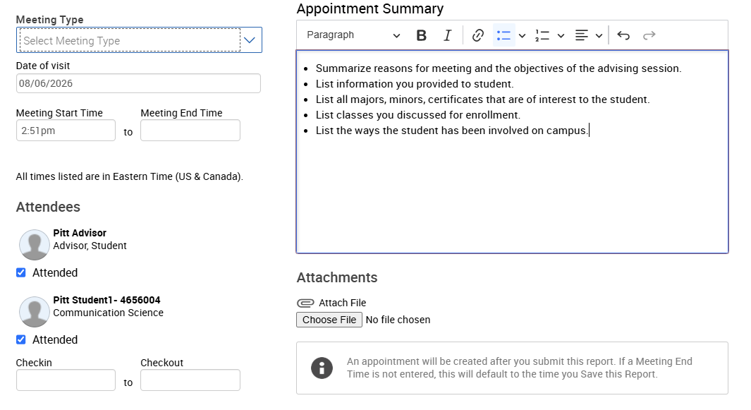
Sample Appointment Summary (cont.)
Introduction to Pathways

Slide 10
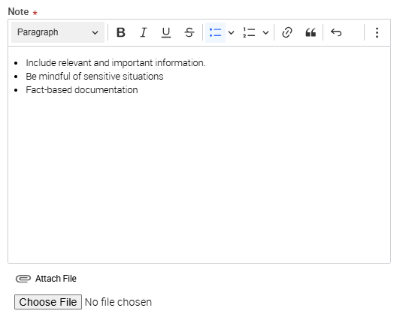
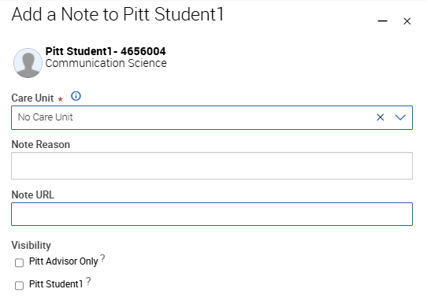
Sample Note
Introduction to Pathways

Slide 11
Best Practices and FERPA Guidance
The next section covers additional guidance on documentation and student records

Slide 12
Documentation Best Practices
Do | Don’t
Focus on key takeaways, recommendations, and next steps | Document every detail of a conversation
Write for a broad audience | Use acronyms, jargon, or unclear language
Stick to facts and observable information | Include opinions, assumptions, or judgements
Share only information needed to support the student | Include unnecessary sensitive details
Include only relevant supporting documentation | Attach private or confidential content
Follow appropriate emergency procedures | Use Pathways to document emergencies
Introduction to Pathways

Slide 13
Pathways Student Records
Every appointment summary and note you enter becomes part of the official student record; there is no such thing as informal documentation in Pathways
Under FERPA, students may request access to their student record
Documentation may be visible to other Pathways users who support the student, including the Dean of Students Office and the Office of the Provost
Documentation is lasting; ensure your documentation holds up long after the conversation, and could not disadvantage the student if released
For sensitive situations, keep details to a minimum, use neutral language, and seek guidance before documenting
Introduction to Pathways

Slide 14
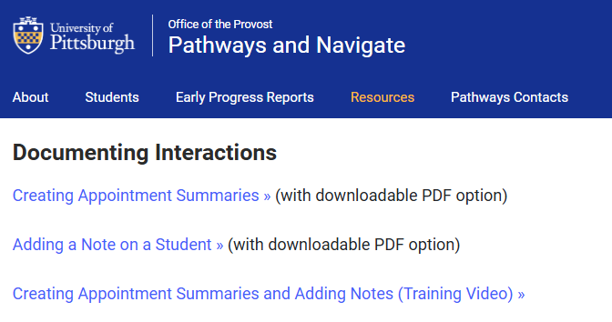
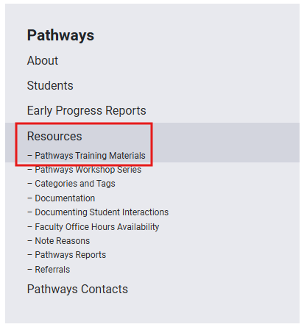
Resources and Support
Introduction to Pathways

Slide 15
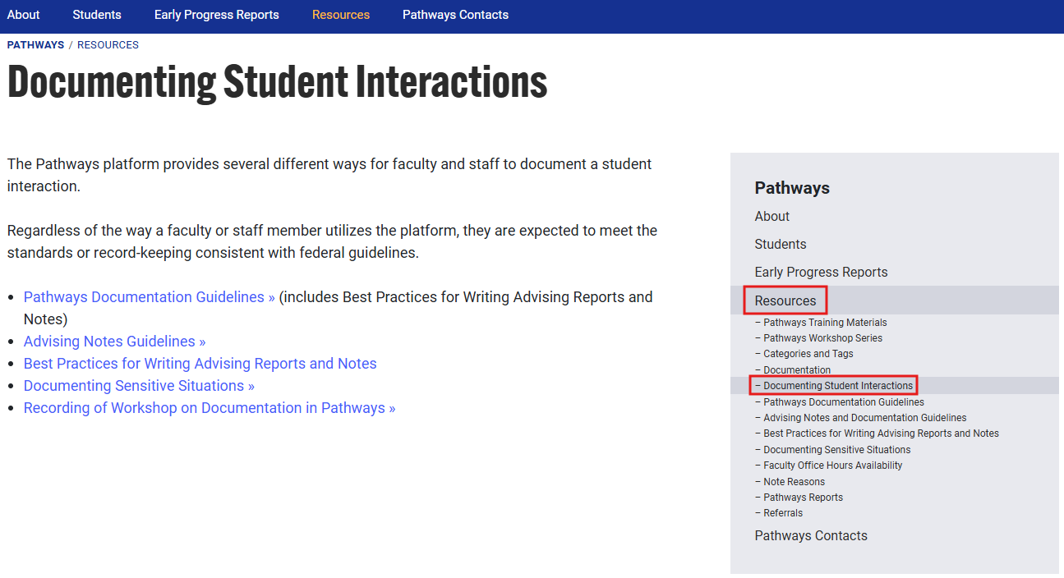
Resources and Support (cont.)
Introduction to Pathways

Slide 16
Resources and Support Documents
Creating Appointment Summaries
Adding a Note on a Student
Creating Appointment Summaries and Adding Notes Video
Documenting Student Interactions
Introduction to Pathways

Slide 17
Questions?
Contact SST-Technology@pitt.edu

