Slide 1
Advising with Pathways:
Recent Updates, Tools, Tips and Reminders

Slide 2
Recent New Features
AI Message Content Creator
AI Report and Filter Finder
Pre-appointment Questions, Post-appointment Feedback and Required Appointment Comments

Slide 3
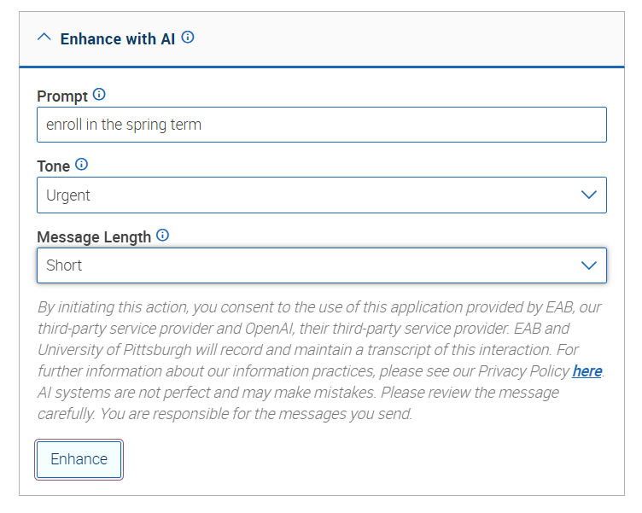
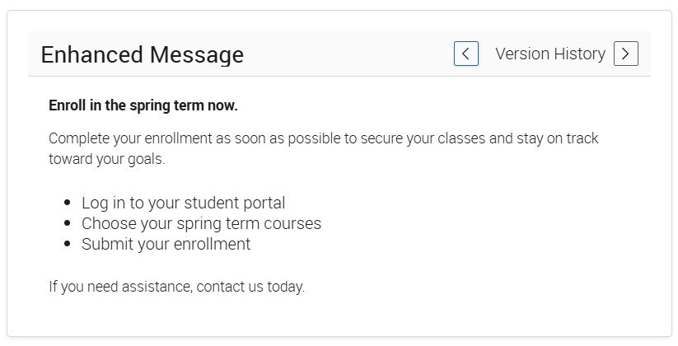
AI Message Content Creator
Utilize the AI Message Content Creator to draft or update messages to students

Slide 4
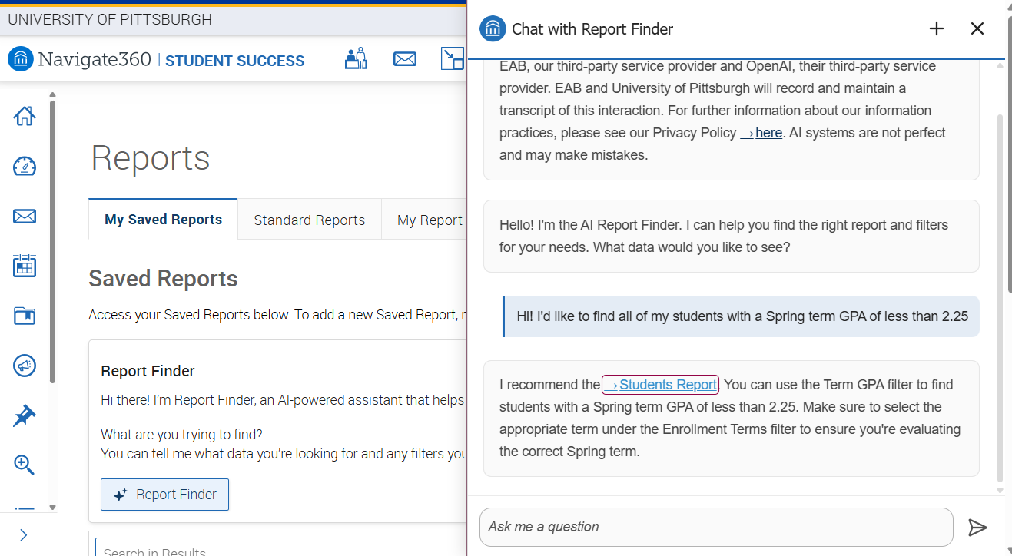
AI Report Finder and Filter Assistant
Use the report finder and filter assistant to get a head start on the filters you need for a Pathways report

Slide 5
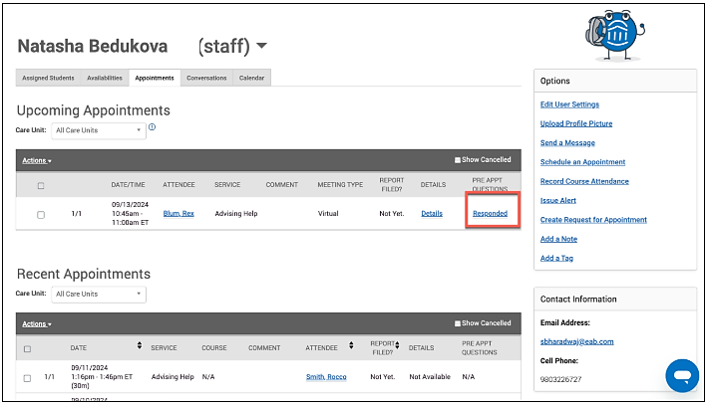
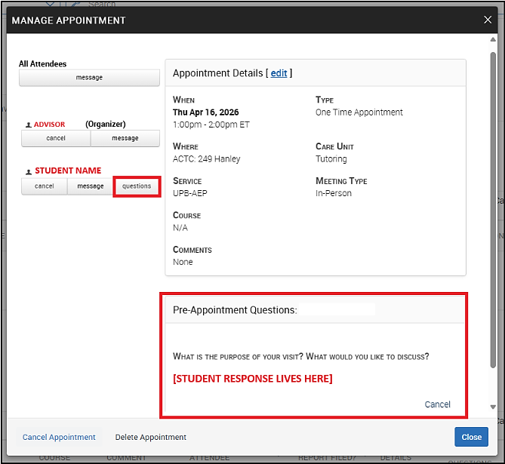
Pre-Appointment Questions
Responses are viewed from the Appointments tab – Select the link from the Pre Appt Questions column
Required Comments when Scheduling – It is also now possible to require students to leave a comment when scheduling an appointment

Slide 6
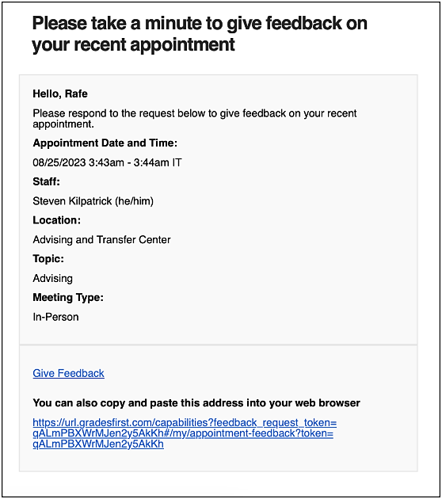
Post-Appointment Feedback
When/while an Appointment Feedback template is active, students with appointments will receive the Appointment Feedback email/SMS request.
Feedback emails/SMS generate between 8 AM and 8 PM EST.
The email notification has a link to the survey (Give Feedback) for the student to fill out:

Slide 7
Updates to Existing Features
Care-unit Associated Notes
Campaign Updates: Copying Campaigns, Restricted Scheduling for Group Campaigns, ‘Send From’ Capabilities
Case Management Updates

Slide 8
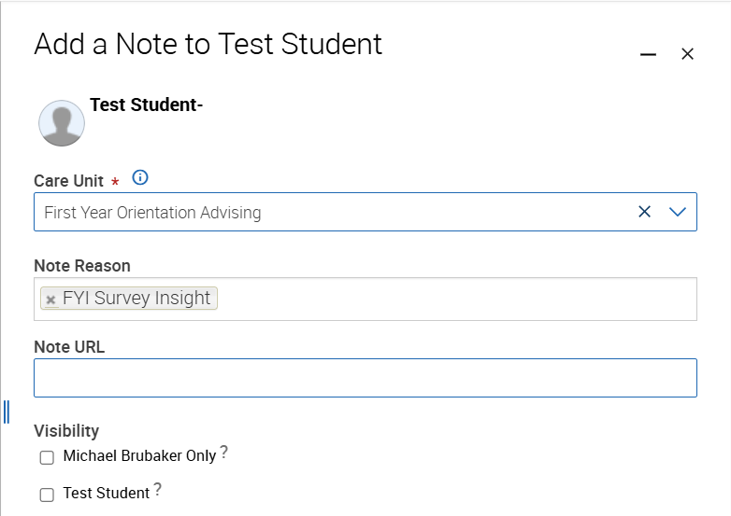
Notes Associated with a Care Unit
Notes now have the ability to be associated with Care Units – similar to appointments and appointment summaries
When a note is associated with a care unit, only users with access to see notes in that care unit will be able to see the note
This is currently only being used with First Year Intake Survey Insights, associated with the First Year Orientation Advising Care Unit, but future updates may include additional care unit associated notes

Slide 9
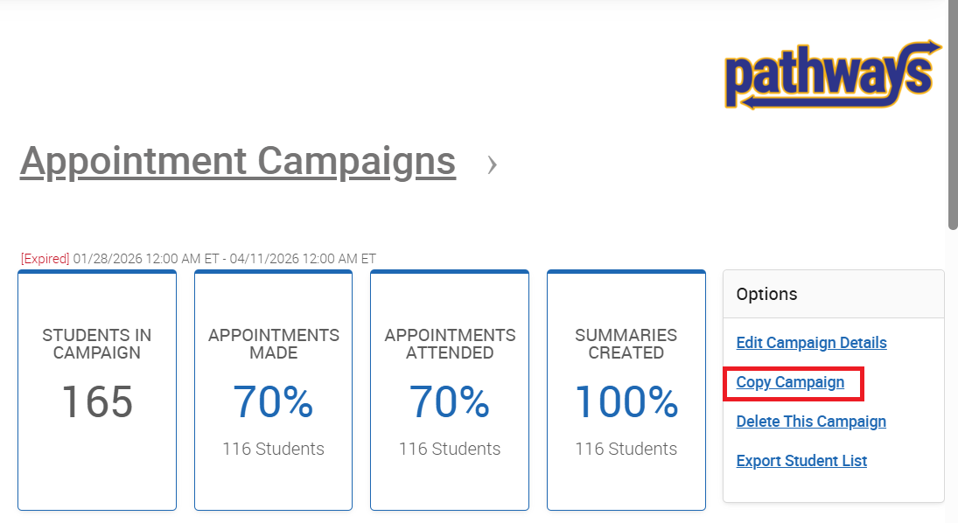
Campaign Updates – Copying Campaigns
The copy opens in draft with the original name plus “(copy)”
All details carry over except the recipient list, which you must add before launching
You can copy active or expired campaigns – for Appointment Campaigns, staff with deleted availability won’t be included

Slide 10
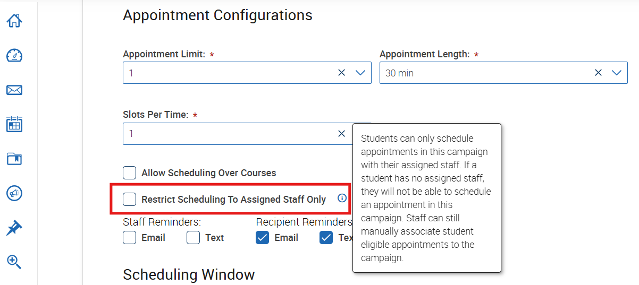
Campaign Updates – Restricted Scheduling for Group Campaigns
Appointment campaigns with multiple staff can be restricted so that students can only schedule with their assigned staff
Allows for one person to create the campaign, while others only create availability
Allows for all appointment data to be associated with a single campaign

Slide 11
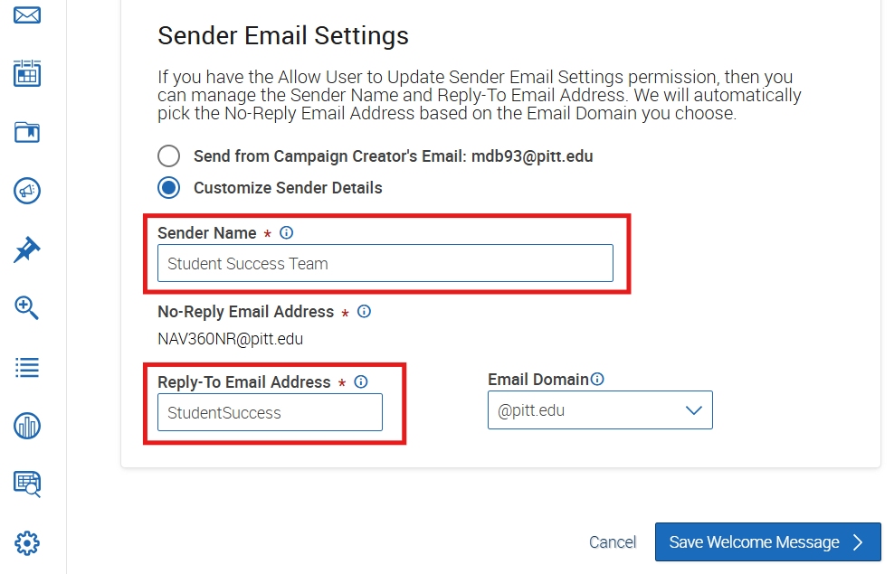
Campaign Updates – ‘Send From’ Permissions
Some users have the permissions to update Sender Email Settings
Campaign messages can appear to be ‘Sent from’ someone else
The reply-to email can also be updated so when students reply to the message, it will go to the selected inbox

Slide 12
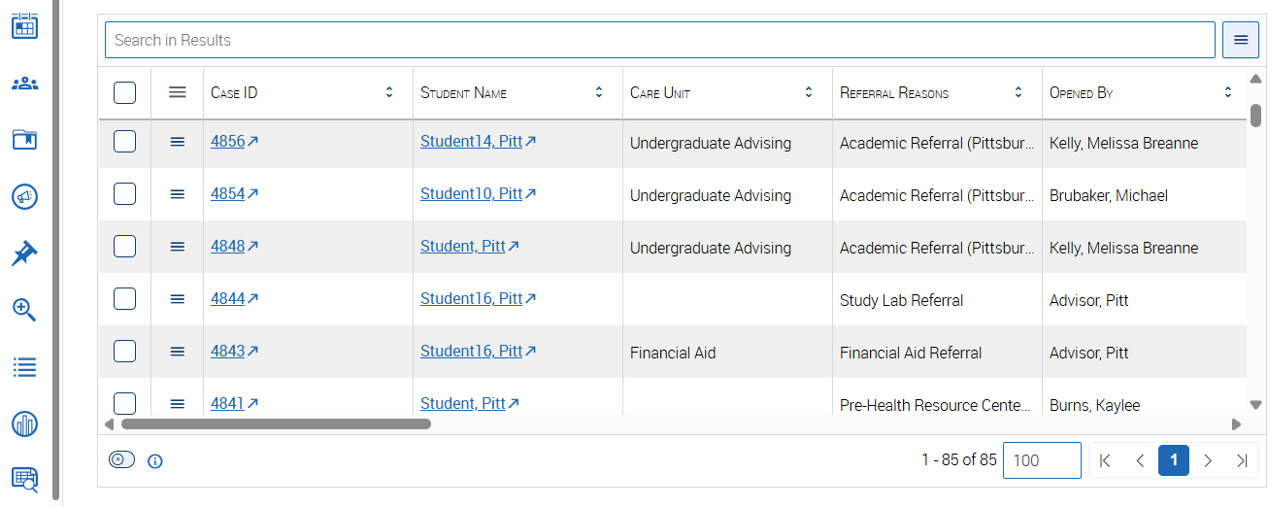
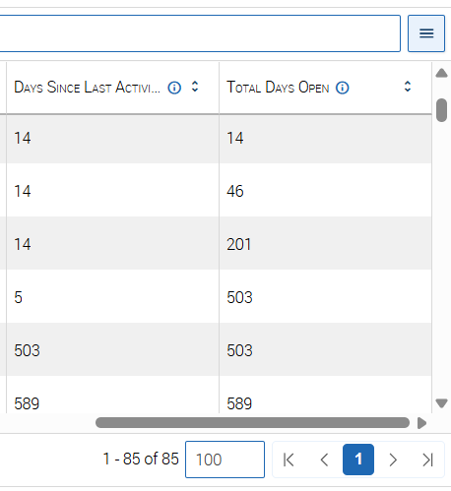
Case Management Updates
Updated Cases page which includes additional columns, and for those with appropriate permissions, built in searching functionality

Slide 13
Case Management Updates (cont.)
New Case Statuses to better track case progress for easier case management
Updated and more detailed Case Closure Reasons to better track case outcomes
Case Status
1st, 2nd, or 3rd Outreach to Student
In Contact with Student
Student Meeting Scheduled
Updated Case Assignee(s)
Extending Beyond 10 Days
Closed
Case Outcomes
No Follow Up Necessary/Resolved Without Additional Intervention
Referred to Other Office
No Sustained Engagement, Provided Intervention Resources
Engaged with Student, Discussed Intervention Resources
Student Did Not Respond to Outreach

Slide 14
Reminders:
Data in Pathways and Tools for Advising
Data in Pathways: Including Categories and Tags
Pathways Reports
Differentiated Support
Student To-Dos and Staff Tasks
Student Checklist Tab
FERPA Reminder

Slide 15




Pathways Platform User-Created Data
Data is also created by university staff and faculty via the daily use of Pathways
Notes Reasons
Appointments & Appointment Summaries
Progress Reports
Referrals & Case
Platform users can also add Tags to students which become useful filters in searches and reports

Slide 16
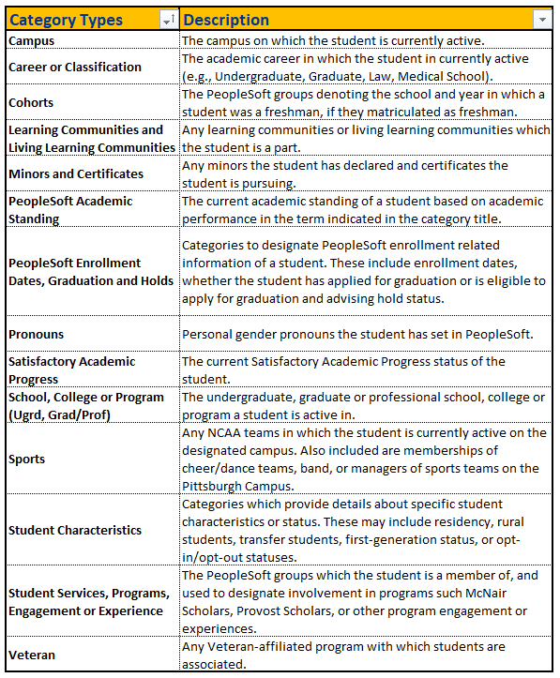
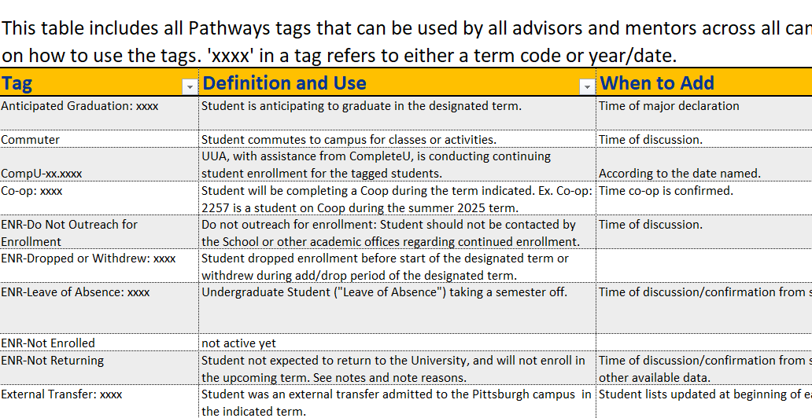
Category and Tag Data
Categories – SIS datapoints (right image)
Tags – User noted datapoints (below image)

Slide 17
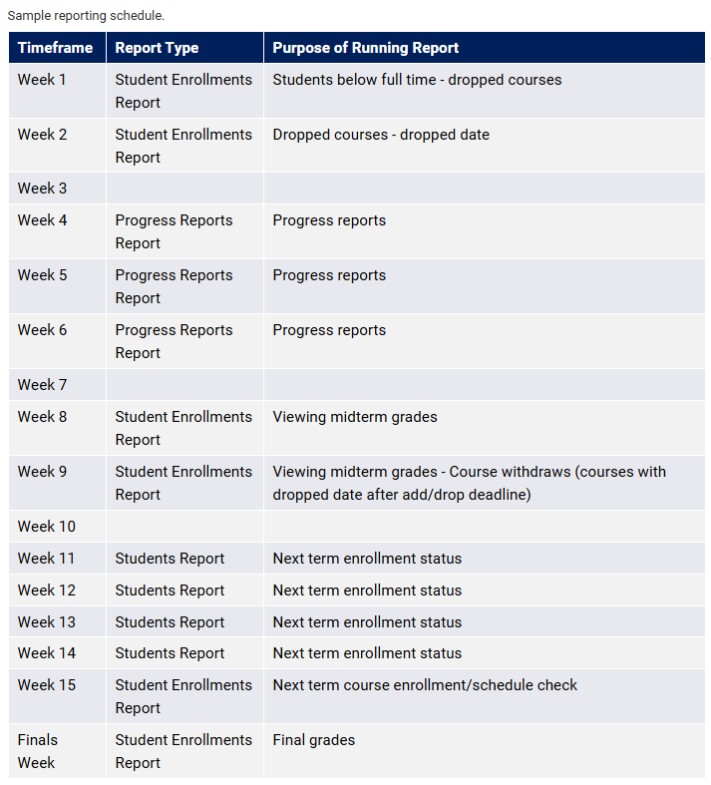
Sample Reporting Schedule
Various reports are useful at different points in the semester
  Student Enrollments report is helpful for checking course schedules at the beginning and end of term
  Progress Reports report should be used during the EPR period
  Students report can be used at any point in the term in place of an advanced search and can be helpful to identify a list of students based on their enrollment status or other SIS data point such as those graduation application status

Slide 18
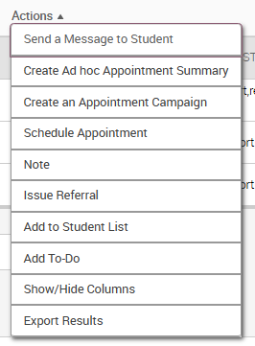
Differentiated Support
Use the Actions button across the platform to quickly take action - In many cases, the results in an advanced search or report provide an opportunity to conduct differentiated outreach.
  Add them to a student list that you can use across the platform
  Schedule an appointment with them Create/add the students to an appointment campaign
  Send them a message
  Issue a referral
  Add a to-do or staff task

Slide 19
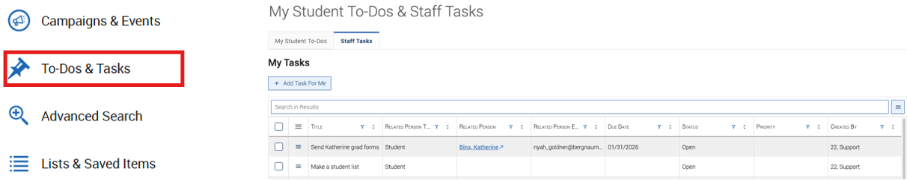
Student To-Dos and Staff Tasks
Student To-Dos
What: To-Dos prompt a future action regarding a particular student. To-Dos can be used to track next steps or follow up on information shared by the student. If your institution has Navigate360 Student, these To-Dos can appear in the Student app. These are not the same as Staff Tasks.
Staff Tasks
What: Staff Tasks enable staff users to create and manage To-Dos for themselves or other staff users. Tasks can be assigned to specific staff users and tied to students, making follow up work visible and trackable within the platform.

Slide 20
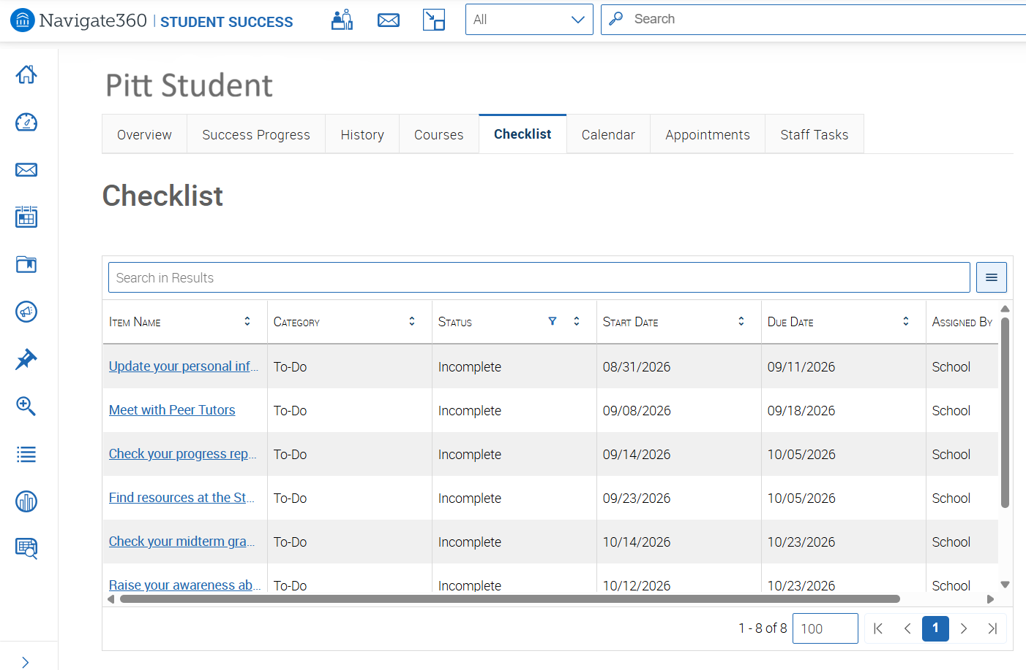
Student Checklist Tab
Student To-Dos added by the school or a staff member show up on the Checklist tab
Journey steps also show up here (Journeys is an upcoming new feature)

Slide 21
Pathways Student Records
Every appointment summary and note you enter becomes part of the official student record; there is no such thing as informal documentation in Pathways
Under FERPA, students may request access to their student record
Documentation may be visible to other Pathways users who support the student, including the Dean of Students Office and the Office of the Provost
Documentation is lasting; ensure your documentation holds up long after the conversation, and could not disadvantage the student if released
For sensitive situations, keep details to a minimum, use neutral language, and seek guidance before documenting

Slide 22

Questions?
✉ PathwaysHelp@pitt.edu // www.provost.pitt.edu/pathways

