Slide 1
Dietrich School Diversity Committee
Kathleen Blee - Associate Dean for Graduate Studies and Research & Chair, Diversity Committee
Rebecca Roadman - Project Coordinator
Diversity Chairs Meeting, October 19, 2015

Slide 2
Diversity Profile
Statement of commitment to diversity
Diversity website

Slide 3
Working with Department Chairs
Dean’s annual evaluation of department chairs now requests information on chairs’ efforts to promote faculty diversity
Presentation on Diversity Committee’s work at annual chairs meeting

Slide 4
Diversity Committee Projects
Year 1 – Recruitment
Year 2 – Mentoring
Year 3 – Department Climate

Slide 5
Recruitment
IMPLICIT BIAS WORKSHOPS (chairs, recruitment chairs, departments):
Provide Research:
Often conflicts with beliefs
Widely shared
Stronger with ambiguity, time pressure, lack of critical mass
Provide Solution:
Additional interviews
Evaluation checklist
Preparing departmental faculty

Slide 6
Mitigating Unconscious Bias in Faculty Searches
Identifying the full range of desired selection criteria (e.g., research excellence, potential for
graduate student mentoring, teaching quality, etc.) before reviewing any candidate files;
2. Deciding how the search will discover and assess the desired selection criteria before reviewing any
candidate files, and at every subsequent stage of the process.
3. Explicitly evaluating each candidate on the full range of selection criteria and rank candidates across these multiple criteria;
4. Avoiding quick judgments of any candidate;
5. Searching for reasons to include rather than exclude candidates from the subsequent round of
evaluations;
6. Giving all excluded candidates a second look before making a final decision to remove them from
further consideration.
7. In advance of the interview stage, deciding on a set of questions that will be posed to each candidate to elicit information about the identified selection criteria.

Slide 7
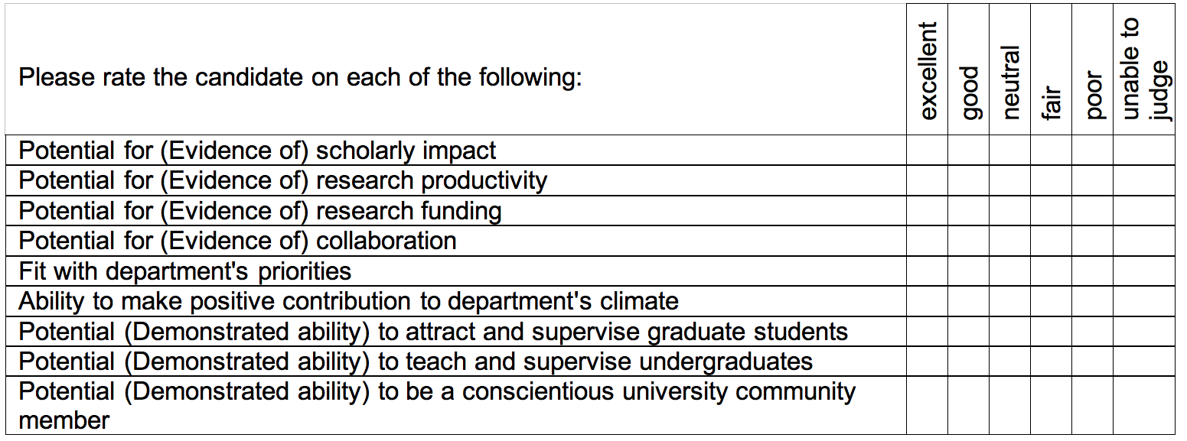
CANDIDATE EVALUATION:

Slide 8
RESOURCE LIST FOR CANDIDATES:
Dietrich School Diversity Committee | http://www.as.pitt.edu/diversity | Chair: Kathleen Blee, kblee@pitt.edu
Gender, Sexuality and Women’s Studies Program | http://www.wstudies.pitt.edu/ | Director: Todd Reeser, reeser@pitt.edu
University Senate Equity, Inclusion and Anti-discrimination Advocacy Committee | http://www.univsenate.pitt.edu/committees/equity-inclusion-and-anti-discrimination-advocacy | Co-chairs: Kacey Marra, marrak@pitt.edu, and Claude Mauk, cemauk@pitt.edu
Provost’s Diversity Institute for Faculty Development | http://www.provost.pitt.edu/faculty-development/index.html | Sr. Ass. to the Provost: Victoria Lancaster, vlanc@pitt.edu
Center on Race and Social Problems | http://www.crsp.pitt.edu/ | Director: Larry Davis, crsp@pitt.edu
Equipoise (provides fellowship & development opportunities for Black and African Americans) | http://www.equipoise.pitt.edu/ | equipoise@pitt.edu
Office of Office of Affirmative Action and Diversity Services | http://www.hr.pitt.edu/diversity/affirmative-action-and-diversity-services | Assoc. Vice Chancellor: Pam Connelly, pwc4@pitt.edu
Provost’s Advisory Committee on Women’s Concerns (PACWC) | http://www.provost.pitt.edu/pacwc/index.html | Sr. Ass. to the Provost: Victoria Lancaster, vlanc@pitt.edu
Disability Resources & Services | http://www.studentaffairs.pitt.edu/drsabout | Director: Leigh Culley, lculley@pitt.edu
Allies Network (to improve visibility & support to LGBTQIA students & employees) | http://www.studentaffairs.pitt.edu/lgbtqia/allies-network
Transgender Resources (names, facilities, healthcare, discrimination/harassment, safety) | http://www.studentaffairs.pitt.edu/lgbtqia/transgender

Slide 9
Mentoring Faculty: Defining the Problem
Focus groups
Survey based on findings from focus groups
https://pitt.co1.qualtrics.com/jfe/preview/SV_afTNeTKa1c1Fx0F

Slide 10
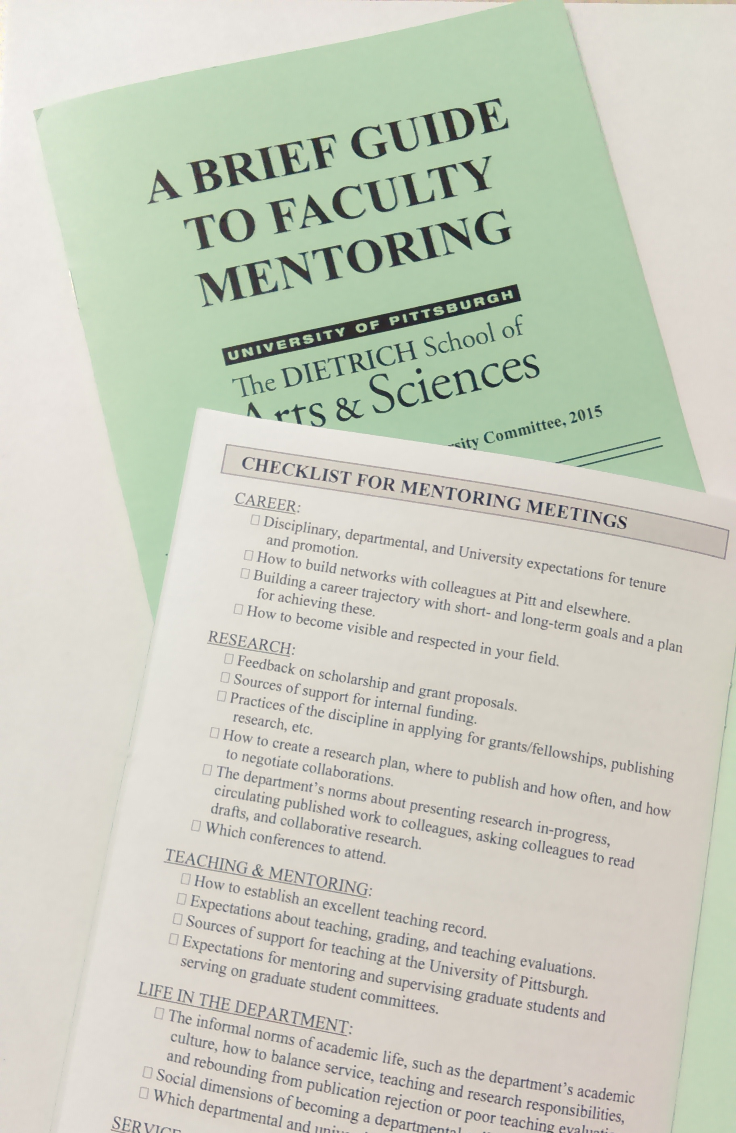
Mentoring Faculty: New Directions
A Brief Guide to Faculty Mentoring
Sections on:
Role of the Chair
Checklist for mentoring meetings
Tips for mentors
Tips for mentees
Workshop on mentoring faculty in chairs and in new chairs training, and annual chair meeting
Mentoring lunch kick-off with Audrey Murrell
Mentoring event for underrepresented junior faculty

Slide 11
Departmental Climates
Information gathering
Strategies for improving climate

